Slide 1
Lies….

Slide 2
Deceit…

Slide 3
Traps…

Slide 4
Tests

Slide 5
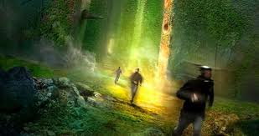

Slide 6
Schemes

Slide 7
Unpleasant Surprises

Slide 8
These are all things WICKED has brought to the Gladers.

Slide 9
WICKED HEADQUARTERS

Slide 10
All for a cure to the worst disease ever to harm mankind…

Slide 12
The Flare

Slide 13
This is Thomas…

Slide 14
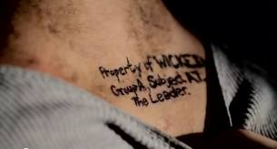

Slide 15
Three weeks

Slide 17
That’s how long Thomas has been isolated.

Slide 19
Three weeks, he and his friends have been put through stage 3 of The Trials.

Slide 20
All of these trials have been for one purpose…

Slide 22
To find a cure for the brain-eating disease

Slide 23
They have reached the final step- to use the information from torturing these people to create a cure.

Slide 24
Now, WICKED has asked for their trust.

Slide 25
Will Thomas and his friends help them?

Slide 27
Can they trust WICKED after all of their lies?

Slide 28
They may have no choice.

Slide 29
Two of their very own have The Flare.

Slide 30
Join Thomas and the Gladers on their quest for the cure.

Slide 31
Find out if WICKED really is trustworthy.

Slide 32
The final book in the Maze Runner Trilogy

Slide 34
Credits
Dashner, James. The Death Cure. New York: Delacorte, 2013. Print.
http://www.photo-dictionary.com/photofiles/list/316/7362handshake.jpg
http://4chandata.org/sci-23-20-1
http://thequietvoice18.files.wordpress.com/2011/11/the-death-cure-by-james-dashner.jpg?w=500\
http://www.philipstraub.com/assets/illustrations/witn_osgiliath.jpg
http://24.media.tumblr.com/tumblr_lyzkfb0a6T1ql2idfo1_r2_250.gif
http://upload.wikimedia.org/wikipedia/commons/a/a5/Injection_Syringe_01.jpg
http://fc08.deviantart.net/fs25/i/2008/069/3/7/White_Room_1080p_by_Tsylord.jpg
http://b.vimeocdn.com/ts/137/607/137607449_640.jpg
http://static.tumblr.com/ivbkqma/Dnrlx4huk/property_of_wicked.png
http://www.wired.com/reviews/wp-content/uploads/2012/11/20121107-VICTORINOX-WATCH-197edit.jpg
http://www.polyvore.com/cgi/img-thing?.out=jpg&size=l&tid=28021264

